Slide 1
Lecture
Serialization & Deserialization

Slide 2
Streams
A stream is flow of data.
Input stream is a flow of data into your program.
Output stream is a flow of data coming from your program.
In .NET, a stream is an object that represents a sequence of bytes.
You work with objects that deal with the input and output streams.
A stream object deals with reading and writing data at the byte-level.

Slide 3
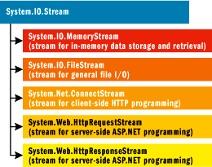
Stream Classes
.NET’s System.IO namespace contains the Stream class and a number of classes to aid in using streams.

Slide 4
Writers, Readers, and Streams… Oh My!
There are several related objects that deal with streams.
The Writer object is used to make writing data to streams easier.
The Reader object is used to make reading data from a stream easier.
The Stream object’s responsible for creating the stream of data, and it’s used to either store the stream or transfer/receive the data for communications.
There are difference classes for each of these objects that depend on the type of data and stream.
Writer Object
Stream Object
Stream Media Memory Buffer File Network Message
Stream Object
Reader Object

Slide 5
Working with Streams
Programming with streams is tedious work because you need to deal with data at the byte-level.
It’s becomes a bigger problem as the data structure becomes more complex.
This is where Writers and Readers become helpful.
They allow you to deal with data at a higher-level than the byte-level by using higher-level functions.

Slide 6
Stream Programming Example

Slide 7
Writers/Readers Example

Slide 8
File-Based Writers/Readers Example
Writing data to a File Stream

Slide 9
File-Based Writers/Readers Example
Reading data from a File Stream

Slide 10
Introduction to Serialization
Serialization is the process of converting an object to a stream of bytes.
This process is also called marshalling.
Deserialization is the process of converting a stream of bytes back into an internal representation of a data structure for the purposes of recreating the object or data structure in memory.
In other words, it’s used to reconstruct the object from a stream of bytes.
Reverses the process of serialization.
This process is also called demarshalling.

Slide 11
Introduction to Serialization
Serialization is used for data storage; it allows an object to persist an indefinite period of time, so it can be used later.
Serialization is also used for communications and transmitting data.
It facilitates the transportation of an object over a network.
We have seen this already with Web Services
The proxy class object packages the data to be sent to a web service web method in a SOAP message. The data needs to be serialized before sending.
The Web service does this when it needs to return data, too.

Slide 12
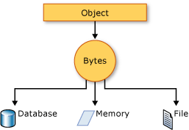
Introduction to Serialization
Serialization

Slide 13




Introduction to Serialization
Serialization & Deserialization
Internet / Network
Serialization
Deserialization

Slide 14
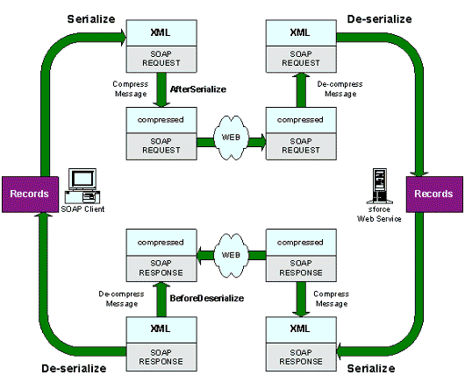
Introduction to Serializations

Slide 15
Types of Serialization
There are several types of serialization that can be used to convert objects into streams.
Binary Serialization
SOAP Serialization
XML Serialization
Custom Serialization
The main difference is the type of data stream and classes used for serializing the object.
Different Formatters are used to handle each of these types of serialization/deserialization.
A formatter is used to control the serialization of an object to and from a stream.

Slide 16
Binary Serialization
This process involves converting objects into a byte stream of binary data.
Creates an exact binary copy of the object.
The BinaryFormatter class can be used to serialize and deserialize objects.
serialize method – used to serialize an object into a type of IO stream.
deserialize method – used to deserialize a stream and turn it back into an object.
The MemoryStream class is used to create a stream of data that is stored in memory.

Slide 17
Binary Serialization
Steps to serializing an object:
First, the object’s class must be marked as serializable.
Also, any class members that are themselves objects must be serializable.
Next, you need to use a BinaryFormatter object to serialize an object into a specific IO stream.
Finally, store the binary data either in a file or database.
Create a byte array with the binary data contained in the memory stream.
Send the byte array to a stored procedure.
Once the object has been serialized, it can be stored in a file or database, or transmitted over a network.
Transmitting a stream of data over the network involves more steps.

Slide 18
Binary Serialization Example

Slide 19
Binary Serialization Example

Slide 20
Binary Deserialization Example

Slide 21
Custom Serialization
A custom serialization can be accomplished by implementing the ISerializable interface.
This interface allows an object to take control of it’s own serialization and deserialization.

Slide 22
Additional Information
BinaryFormatter class
http://msdn.microsoft.com/en-us/library/y50tb888.aspx
MemoryStream class
http://msdn.microsoft.com/en-us/library/system.io.memorystream.aspx
FileStream class http://msdn.microsoft.com/en-us/library/system.io.filestream.aspx
NetworkStream class http://msdn.microsoft.com/en-us/library/system.io.filestream%28v=vs.110%29.aspx

Slide 23
Additional Information
SoapFormatter class http://msdn.microsoft.com/en-us/library/system.runtime.serialization.formatters.soap%28v=vs.110%29.aspx
XMLSerializer class http://msdn.microsoft.com/en-us/library/system.xml.serialization.xmlserializer.aspx

